Slide 1
Xamarin Forms: Advanced Topics
Alejandro Ruiz
Microsoft & Xamarin MVP
alejandro@alejandroruizvarela.com

Slide 2
Agenda
DataTemplate Selector
Themes / Styles
Behaviors
Triggers
Renderers - Effects
Dependency Service

Slide 3
DataTemplate Selector
A DataTemplateSelector can be used to choose a DataTemplate at runtime based on the value of a data-bound property. This enables multiple DataTemplates to be applied to the same type of object in order to customize the appearance of select objects.

Slide 4
Themes / Styles
Xamarin.Forms applications often contain multiple controls that have an identical appearance. Setting the appearance of each individual control can be repetitive and error prone. Instead, styles can be created that customize control appearance by grouping and settings properties available on the control type.

Slide 5
Behaviors
Behaviors lets you add functionality to user interface controls without having to subclass them. Behaviors are written in code and added to controls in XAML or code.

Slide 6
Triggers
Triggers allow you to express actions declaratively in XAML that change the appearance of controls based on events or property changes.
You can assign a trigger directly to a control, or add it to a page-level or app-level resource dictionary to be applied to multiple controls.

Slide 7
Renderers - Effects
Renderers: Xamarin.Forms user interfaces are rendered using the native controls of the target platform, allowing Xamarin.Forms applications to retain the appropriate look and feel for each platform. Custom Renderers let developers override this process to customize the appearance and behavior of Xamarin.Forms controls on each platform.
Effects: Xamarin.Forms user interfaces are rendered using the native controls of the target platform, allowing Xamarin.Forms applications to retain the appropriate look and feel for each platform. Effects allow the native controls on each platform to be customized without having to resort to a custom renderer implementation.

Slide 8
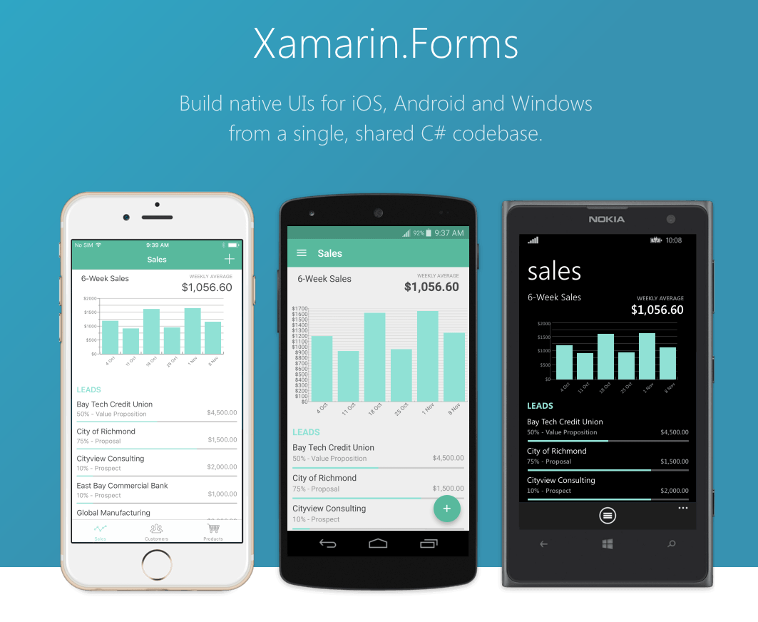

Slide 9
Dependency Service
Xamarin.Forms allows developers to define behavior in platform-specific projects. DependencyService then finds the right platform implementation, allowing shared code to access the native functionality.

Slide 10
Demo Source Code
https://goo.gl/w8o1HC

Slide 11
Questions?
Alejandro Ruiz
Microsoft & Xamarin MVP
Xamarin Forms: Advanced Topics
alejandro@alejandroruizvarela.com
http://alejandroruizvarela.blogspot.com
https://github.com/alejandroruiz
@alejandroruizva

